Slide 1
Bug Tracker: Issue Management Web Application by: Olamide Oso Matriculation Number: 92131562 GitHub Repository: https://github.com/VicvekSr9485/Bug-Tracking-System Date: 25/06/2025 INSTITUTE: INTERNATIONAL UNIVERSITY OF APPLIED SCIENCES

Slide 2
Goal:
To provide software teams with a robust, user-friendly interface for tracking bugs and managing project issues collaboratively. Objectives:
Simplify issue reporting and tracking through structured forms and project-level organization.
Ensure secure and authenticated access to project data via JWT-based login.
Lay the groundwork for role-based access control and collaboration.
Designed as a lightweight alternative to full-scale issue trackers like Jira, tailored for smaller teams and educational use.

Slide 3
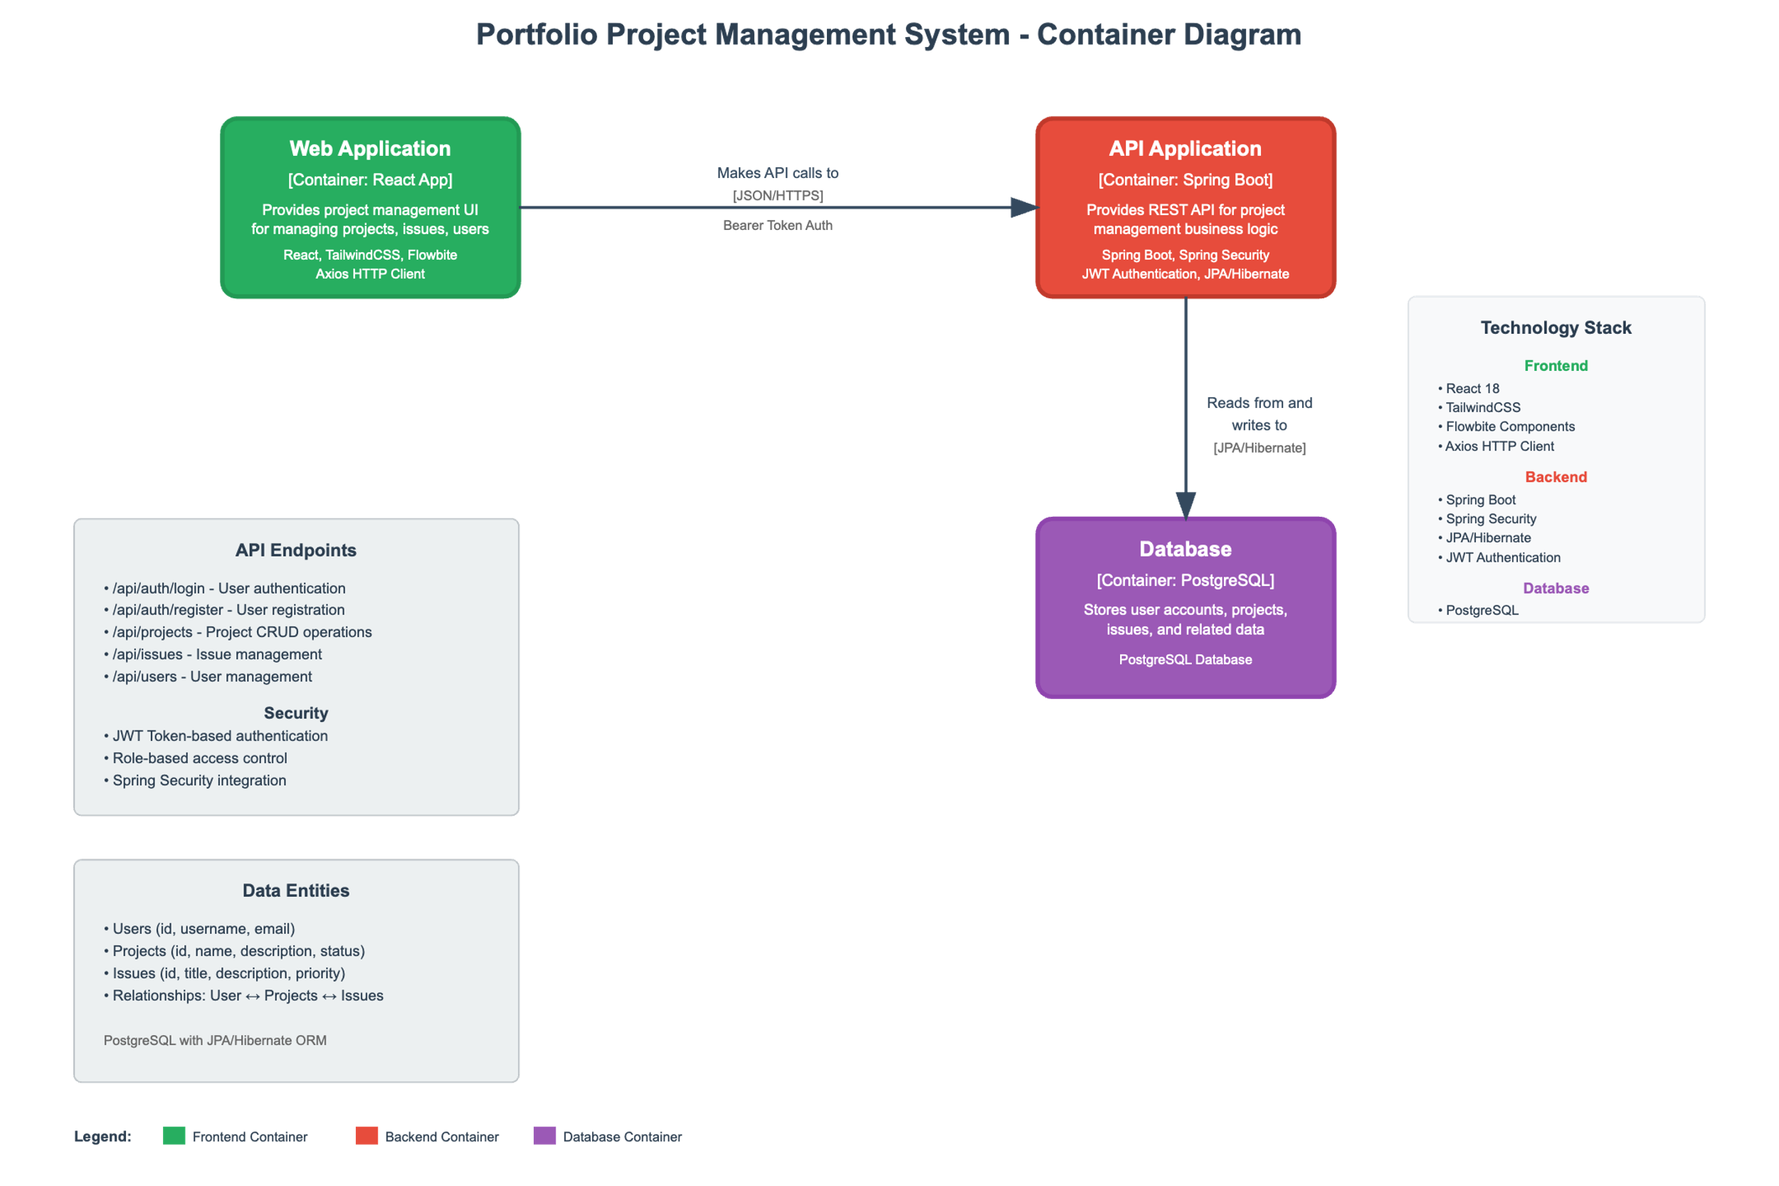
Architecture Diagram(C4 Container)

Slide 4
Technology Stack
Frontend:
React + TypeScript: Component logic and strict type safety
TailwindCSS + Flowbite: Design system for responsive UI
Axios: API interaction
React Router & Context API: Routing and global state
Backend:
Spring Boot 3: REST APIs and configuration management
Java 22: Modern features and performance
Spring Security + JWT: Secure, token-based auth
JPA + H2: ORM-based persistence
Tooling:
Vite (frontend bundler), GitHub, Postman, VSCode, Maven

Slide 5
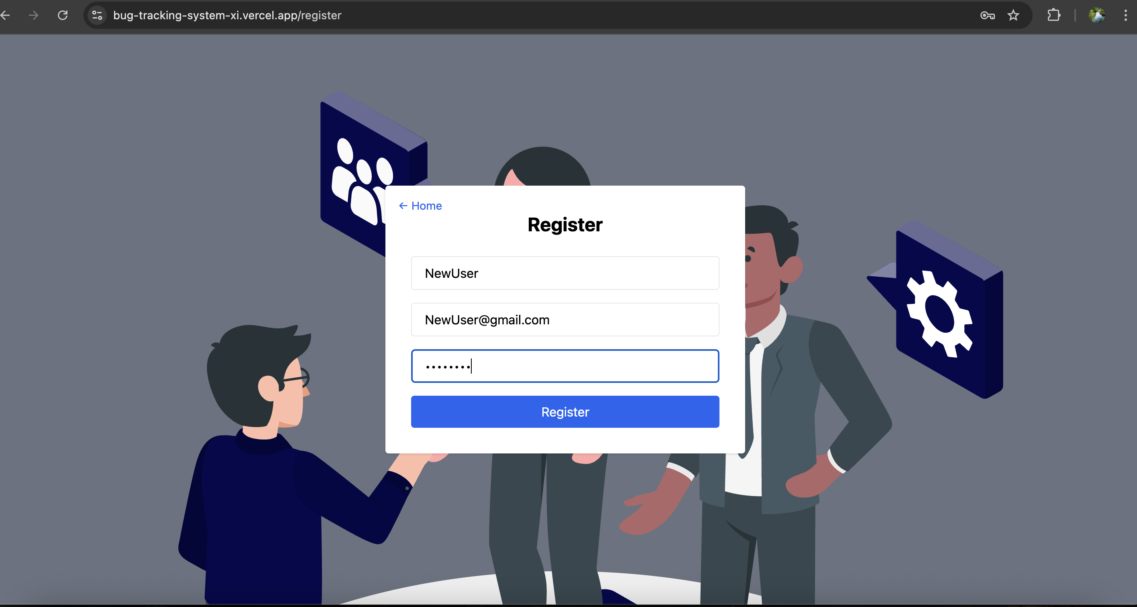
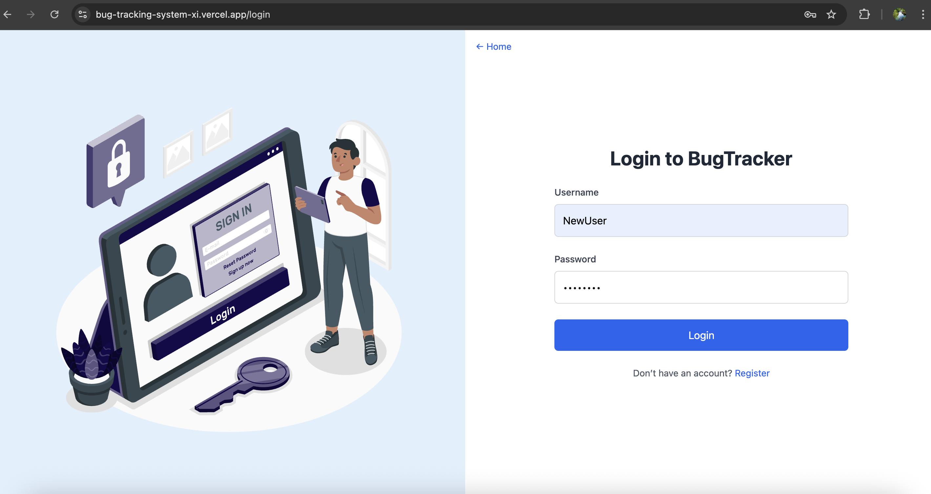
UI Screenshots – Register & Login
Highlights:
Secure JWT-based login/register
Form validation (client + server)
Redirects based on login state
Axios interceptor injects token post-login

Slide 6
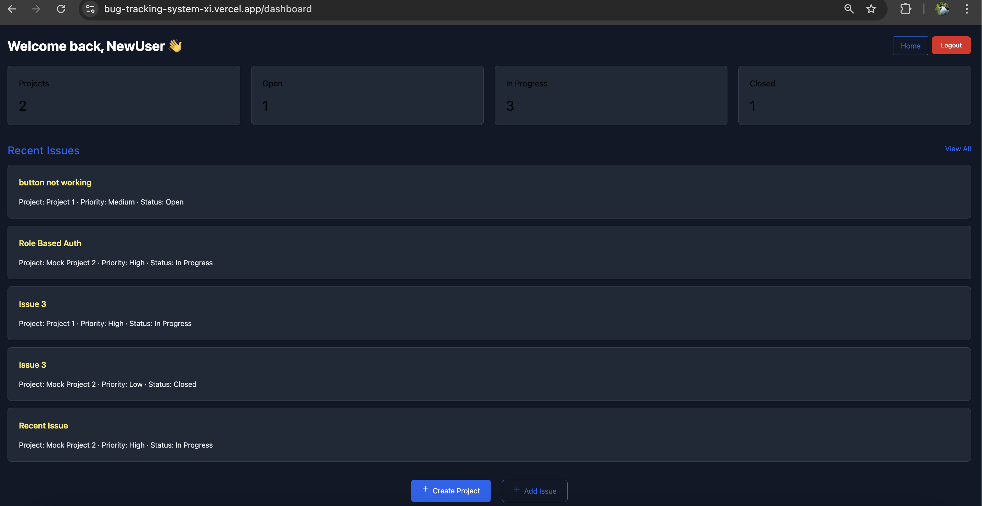
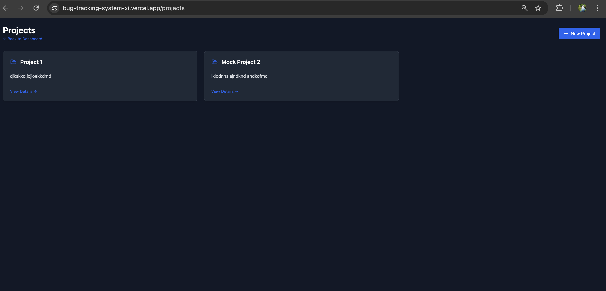
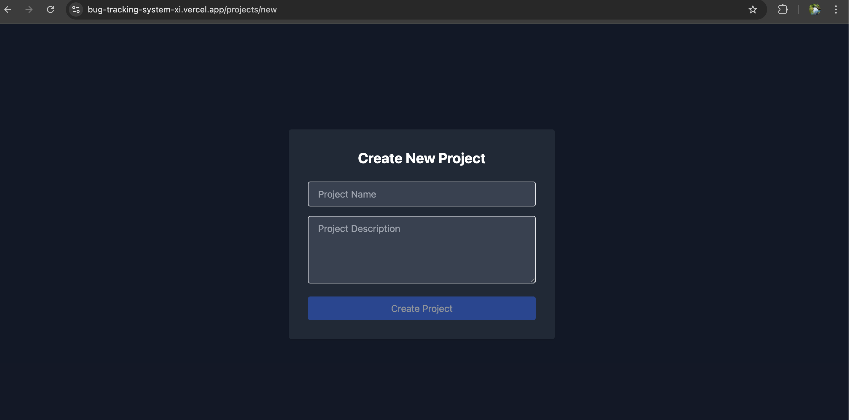
UI Screenshots – Dashboard & Projects
Highlights:
Auth-guarded dashboard
Dynamically fetches projects assigned to the user
Project creation via /api/projects/new with validation
Optimistic UI update with React state

Slide 7
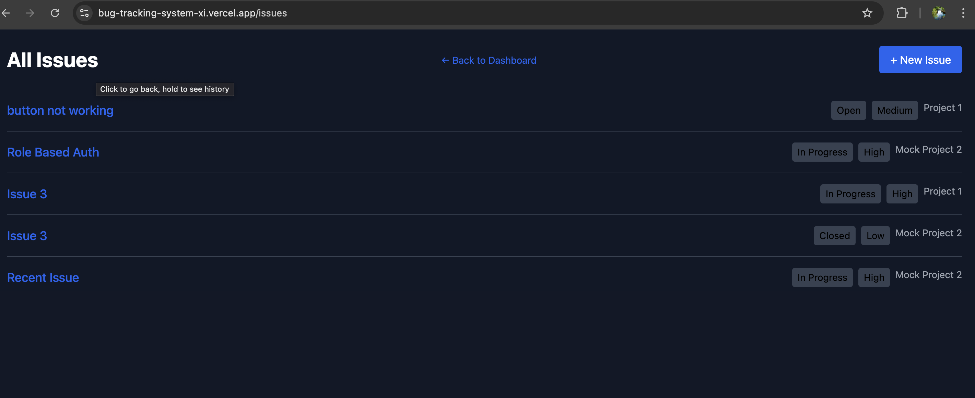
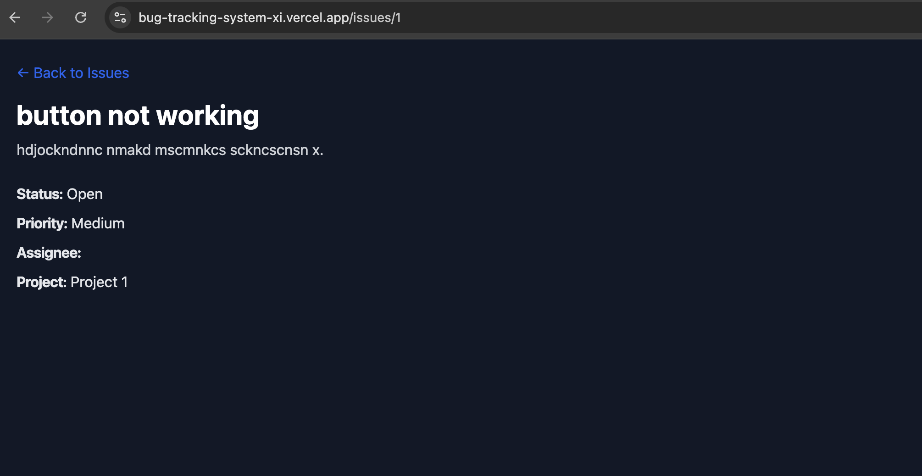
UI Screenshots – Issue Lists & Issue Details
Highlights:
Project-specific issue lists
View details including title, description, status etc.
Issue creation via /api/issues/new with validations

Slide 8
Planned vs Actual Implementation
Feature | Proposed | Implemented | Reason
Role-Based Access Control | Yes | Deferred | Out of MVP scope; prioritized core features
Admin Panel | Yes | Not included | Focus on user-side features for MVP
Session Persistence | No | Yes (via localStorage) | Improved UX, supports persistent login
Form Validation | Partial | Fully implemented | Essential for usability and data integrity
Error Feedback & CORS | Implicit | Centralized via Axios | Improved reliability and user messaging

Slide 9
Development Insights & Key Takeaways
Frontend:
✅ AuthContext enabled global session control and route protection
✅ Axios interceptor simplified token handling across API calls
✅ Flowbite accelerated UI development with minimal styling overhead
⚠ JWT token lacked email → backend update required
⚠ Async route guards needed careful null handling (useParams)
Backend:
✅ DTO layering solved JSON recursion and improved API usability
✅ JWT filter now clearly returns 401/403 responses
✅ Seed data via CommandLineRunner boosted development speed
❌ “user” as entity name caused PostgreSQL errors → renamed to app_user
❌ Duplicate demo data initially persisted → resolved with condition checks
Deployment URL: https://bug-tracking-system-xi.vercel.app/ (Note: Render’s backend free-tier deployment imposes potential slow response times due to sleep mode after inactivity)

Slide 10
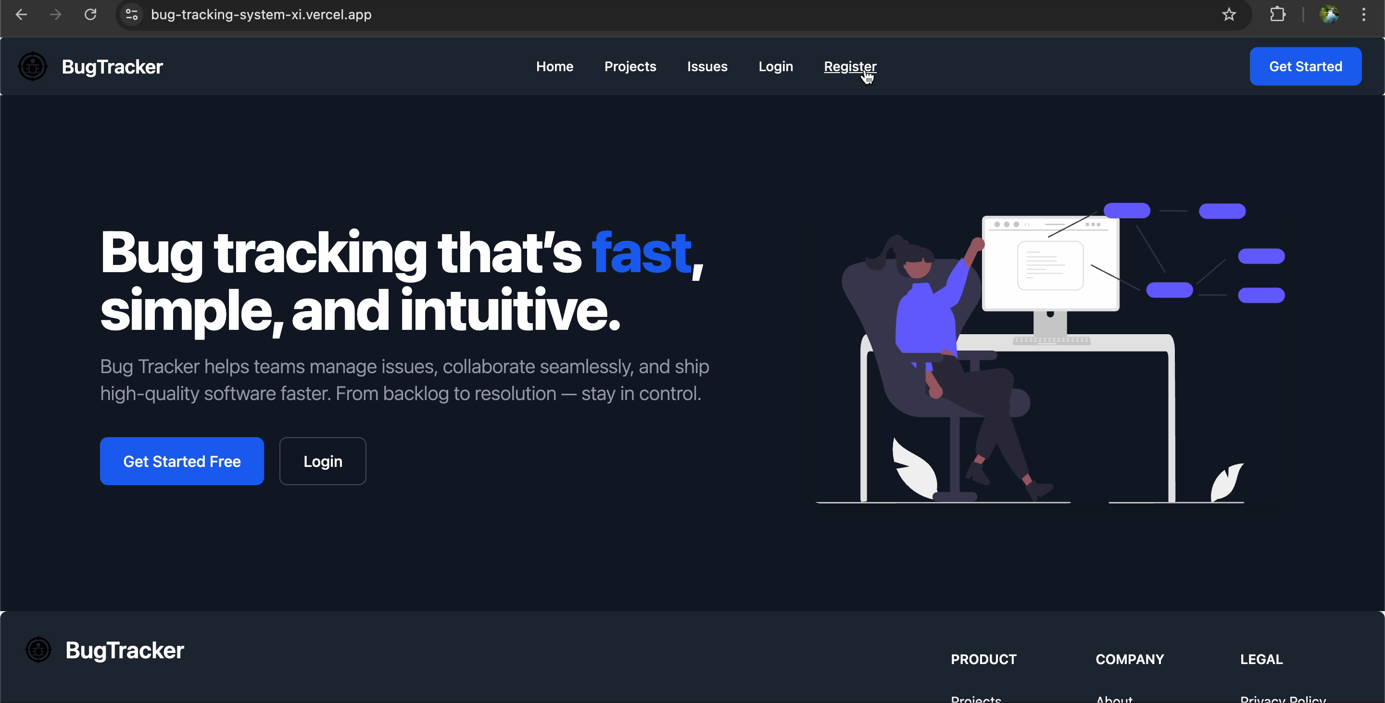

Screencast Demo

